Slide 1




Develop Flutter mobile app for iOS and Android
Mr Nguyen Duc Hoang
Software developer – Techmaster Vietnam
Email: sunlight4d@gmail.com

Slide 2
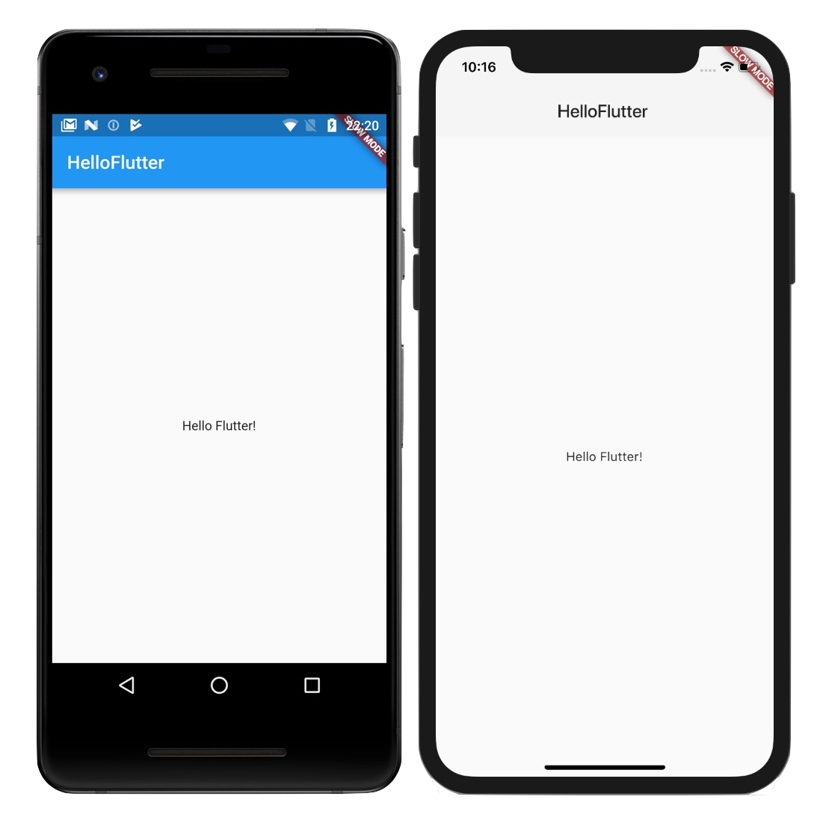


Agenda

Slide 3
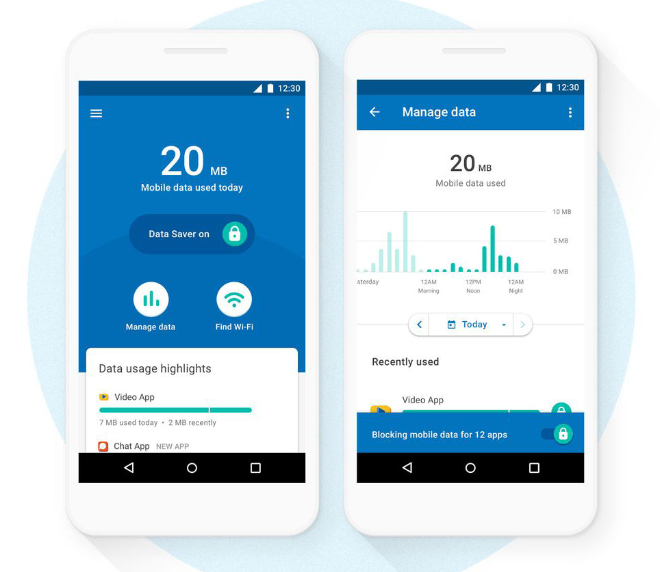
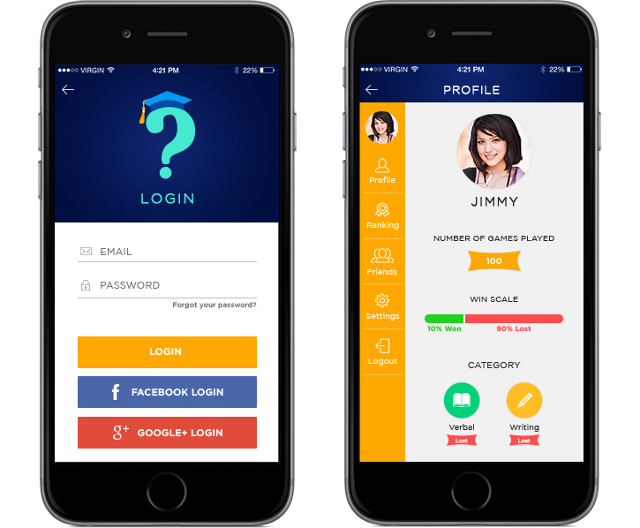
Agenda
Hot Reload in milliseconds
Expressive and Flexible UI
Full native performance

Slide 4
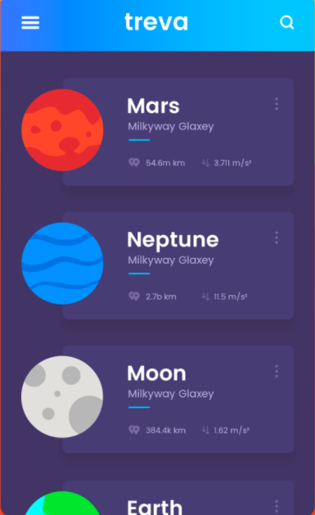

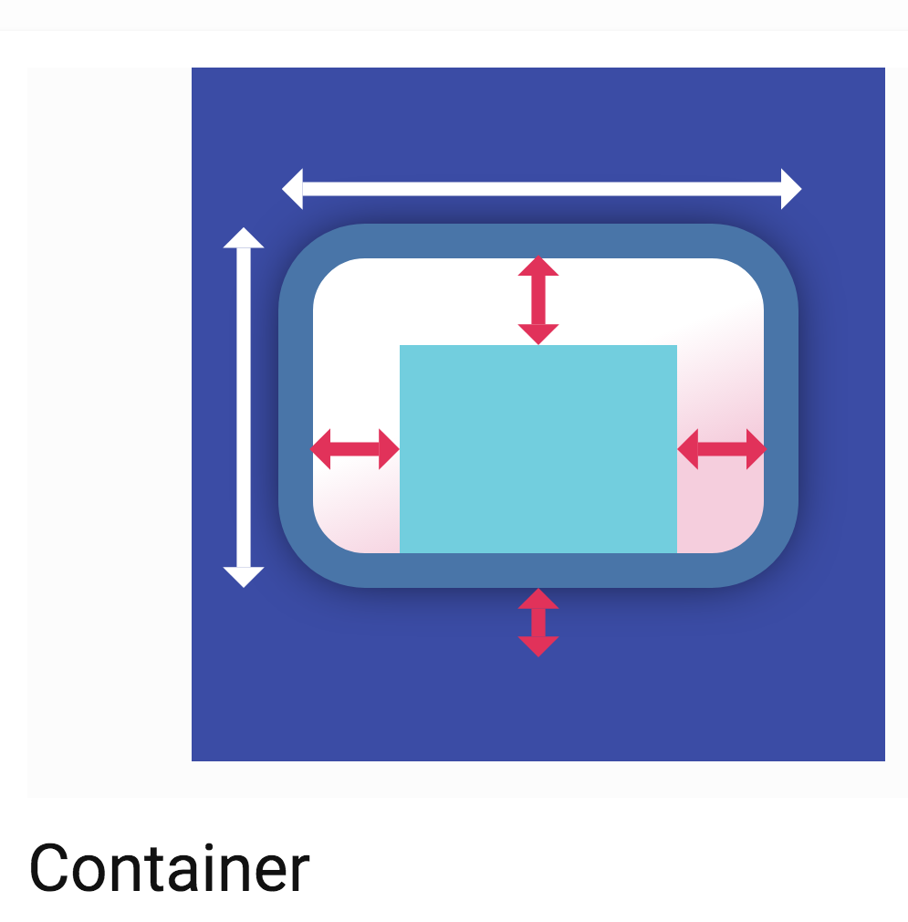
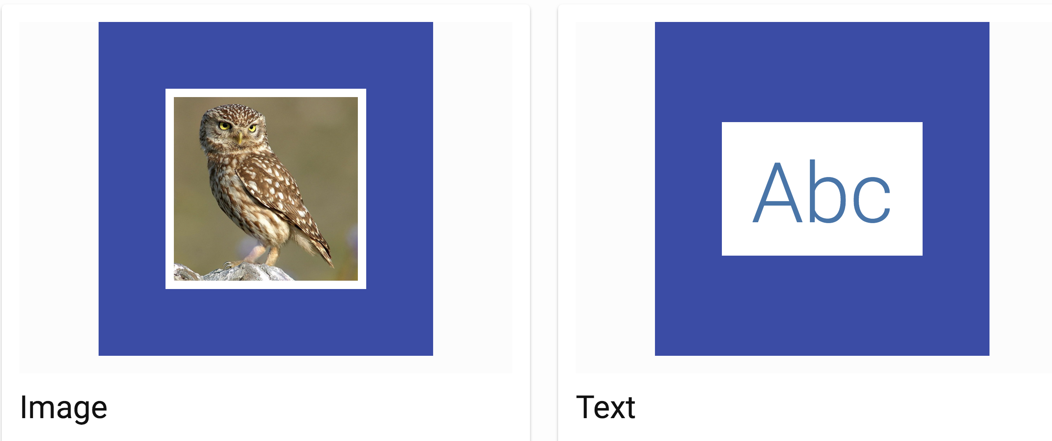
Agenda
What is Flutter widgets ?
ListView
GridView

Slide 5
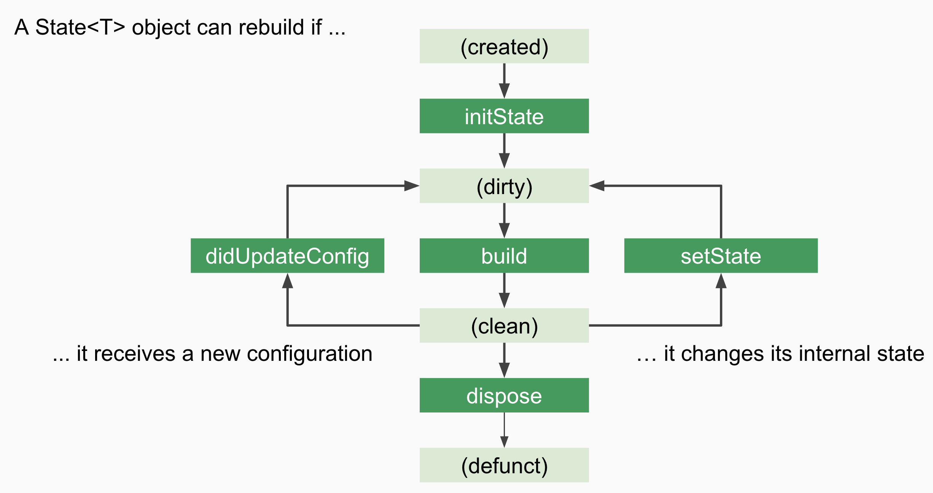
Agenda
Flutter widget Lifecycle
A Stateful Widget
Ex: A widget contains a TextField. User types text to enter his/her name

Slide 6
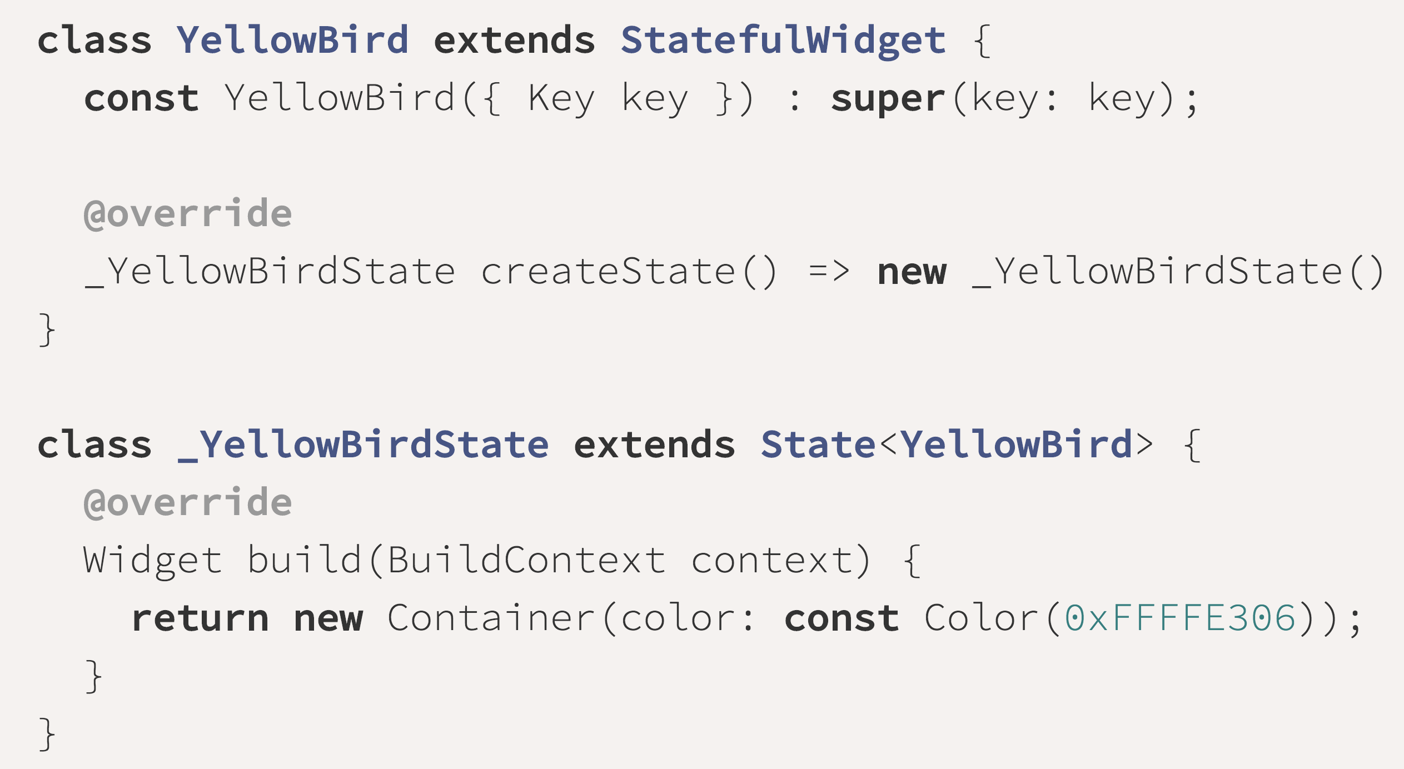
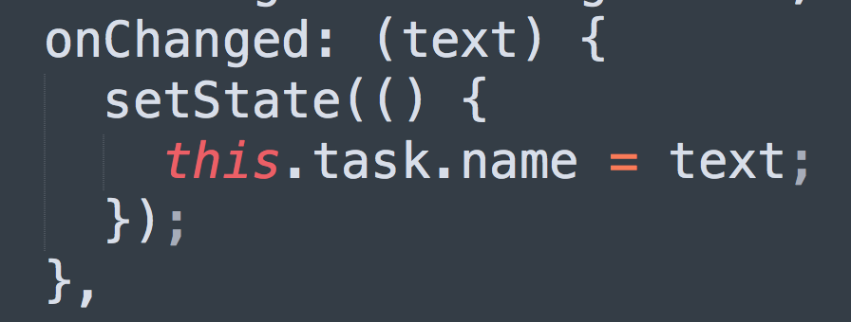
Agenda
How to implement a StatefulWidget ?
You must define 2 classes, state is ”private”

Slide 7

Agenda
Flutter(dart)
iOS(swift)
Widget/ListView
GridView
Navigation
Make UI using Code
Async/await
pubspec.yaml
UIView/UITableView
UICollectionView
UINavigationController
Storyboard / xib
Global / main queue
Podfile

Slide 8

Agenda
Flutter(dart)
Android(Java, Kotlin)
Widget
Navigator
Async / await
Make UI using Code
Container/Row/Column
pubspec.yaml
View
Activity/Intent
runOnUiThread()
Using xml files
Linear/Relative Layout
.gradle file

Slide 9

Agenda
Flutter(dart)
React Native(Javascript)
Widget
Navigator
Async / await
Make UI using Code
Container/Row/Column
pubspec.yaml
Component
ReactNativation
Async/await
Using code
Flexbox layout
package.json

Slide 10
Agenda
Dart is quite “easy to learn”:
-Support Async and await
-Classes, interfaces,…
-Generic types
-Anonymous functions, 1-line functions
-Error handlings

Slide 11
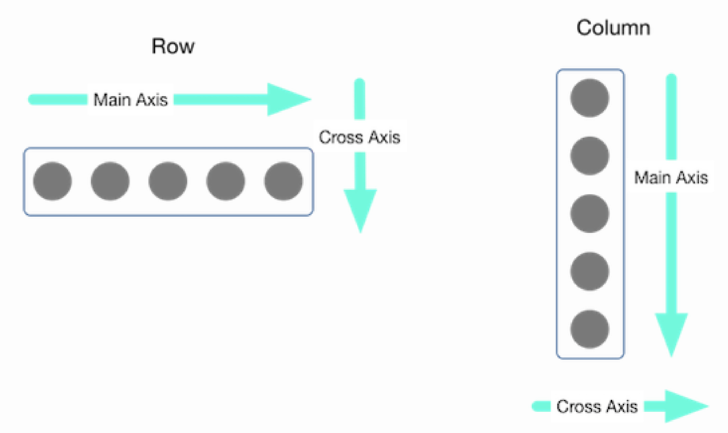
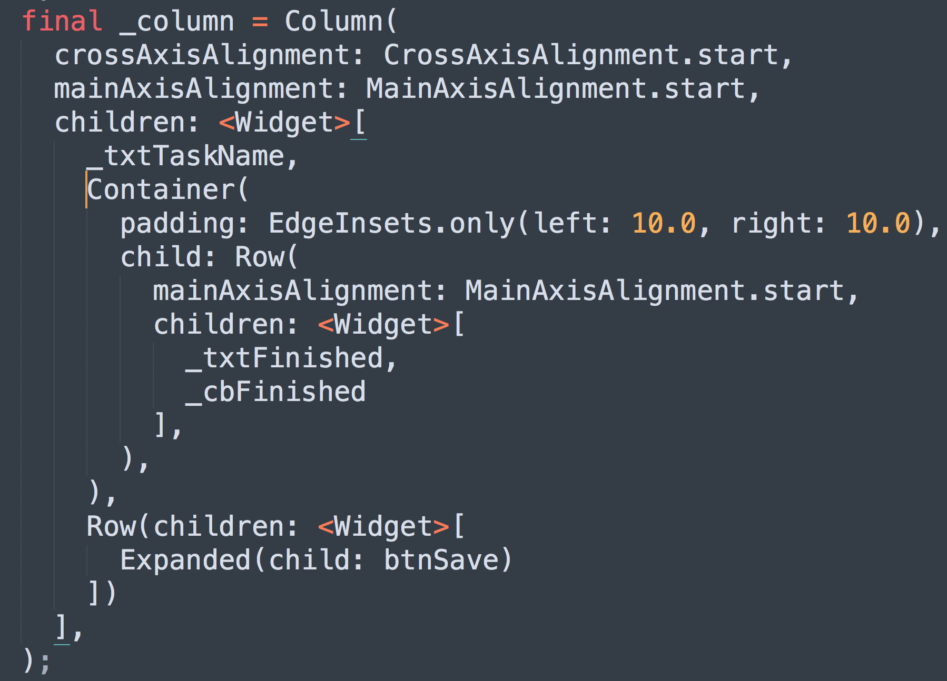
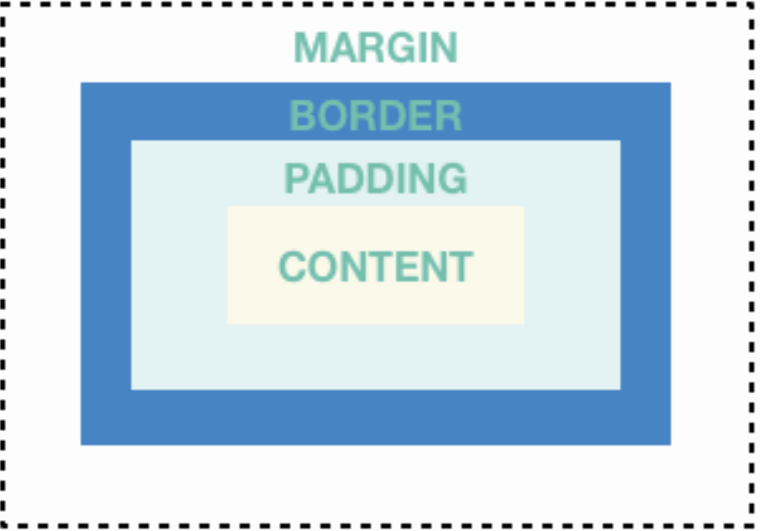
Agenda
Container / Row Column in Flutter
Container

Slide 12
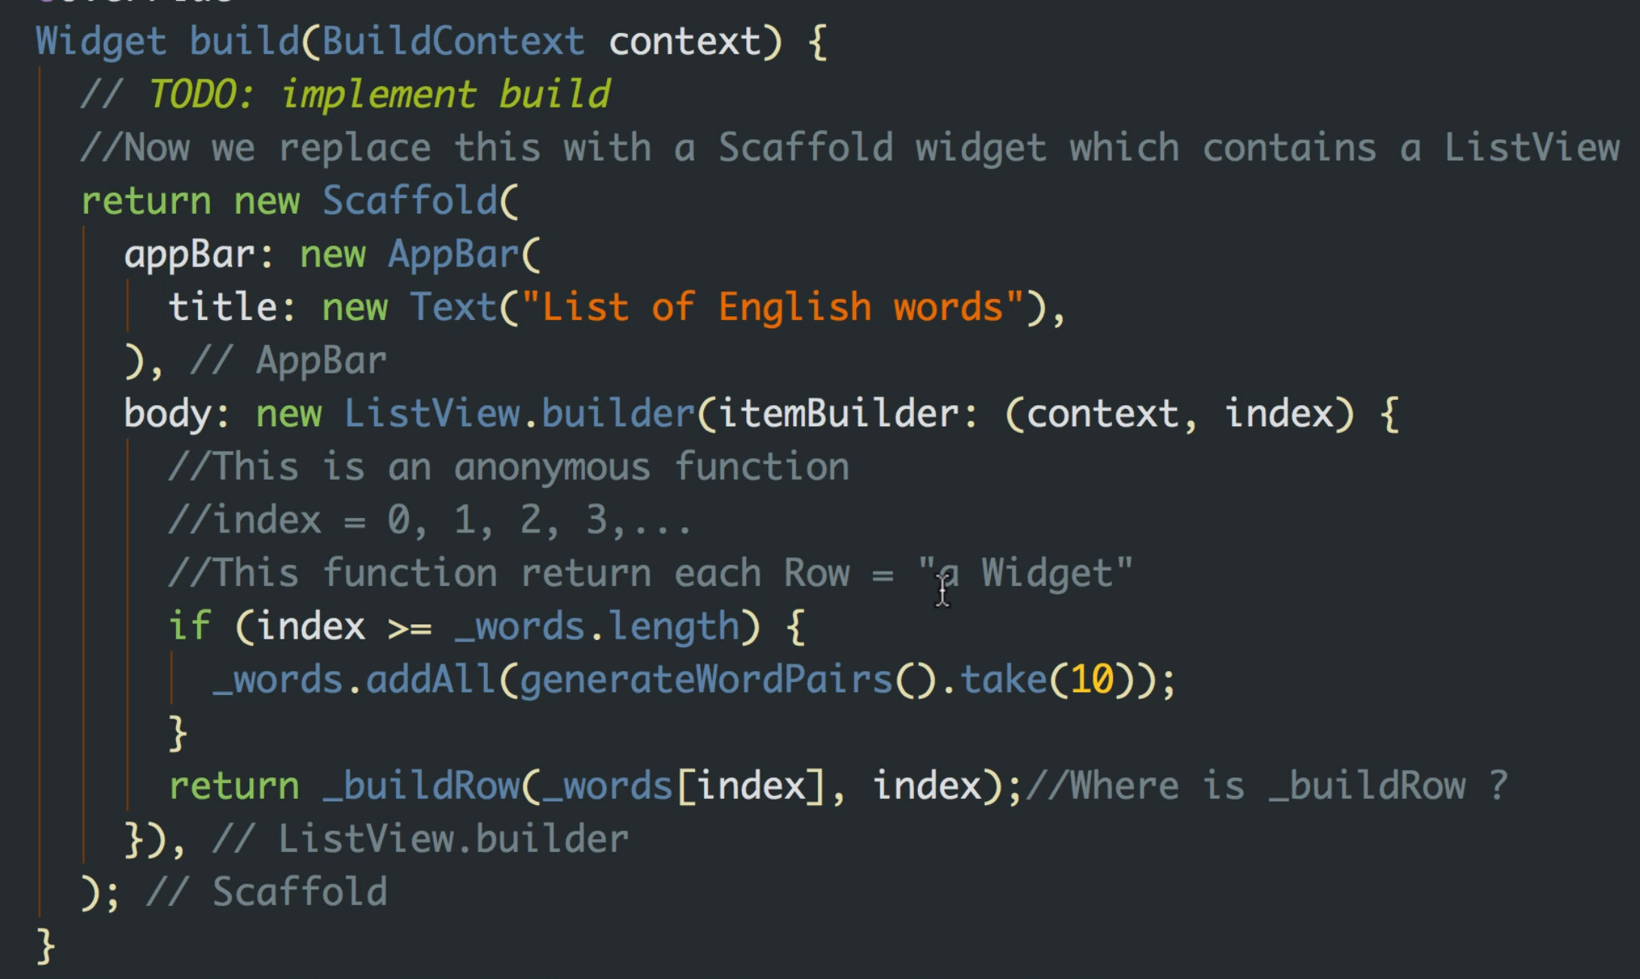
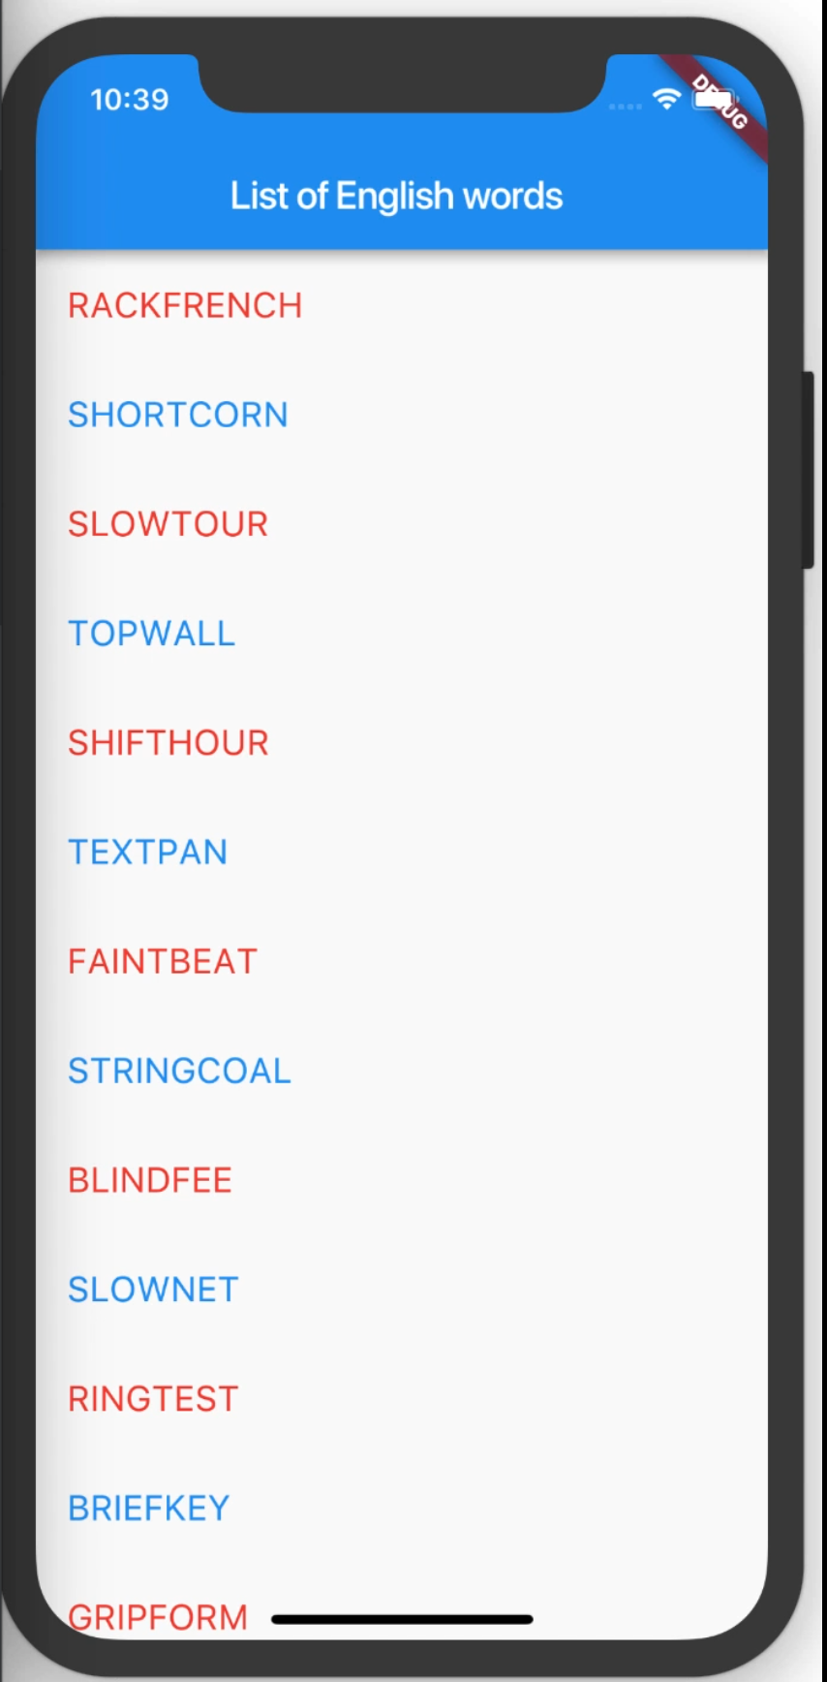
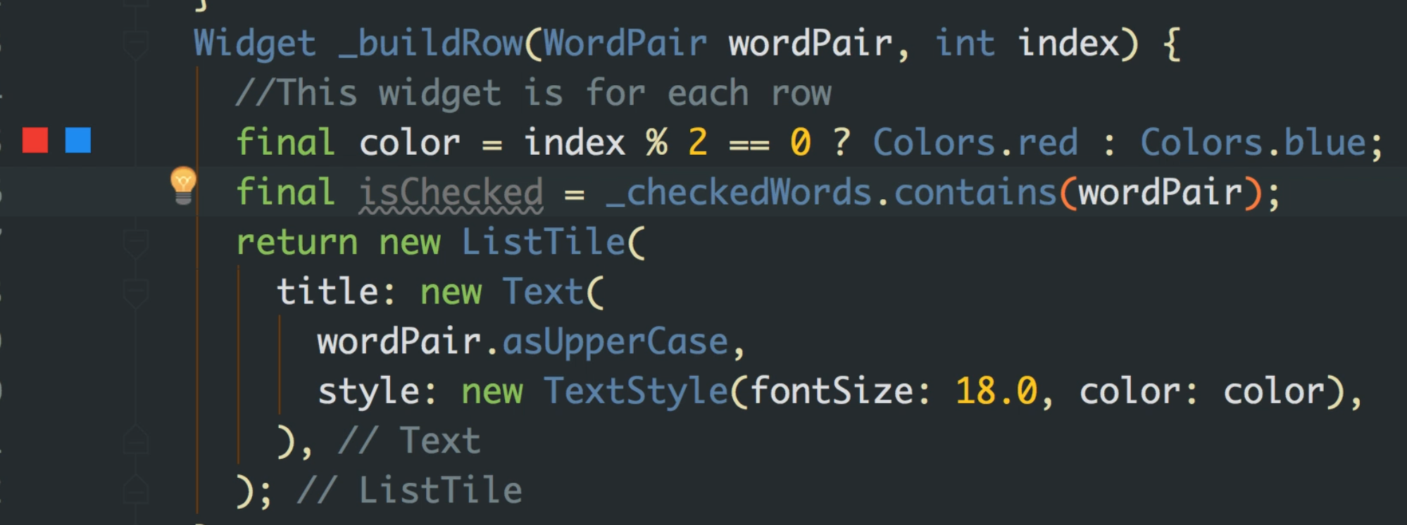
Agenda
ListView

Slide 13
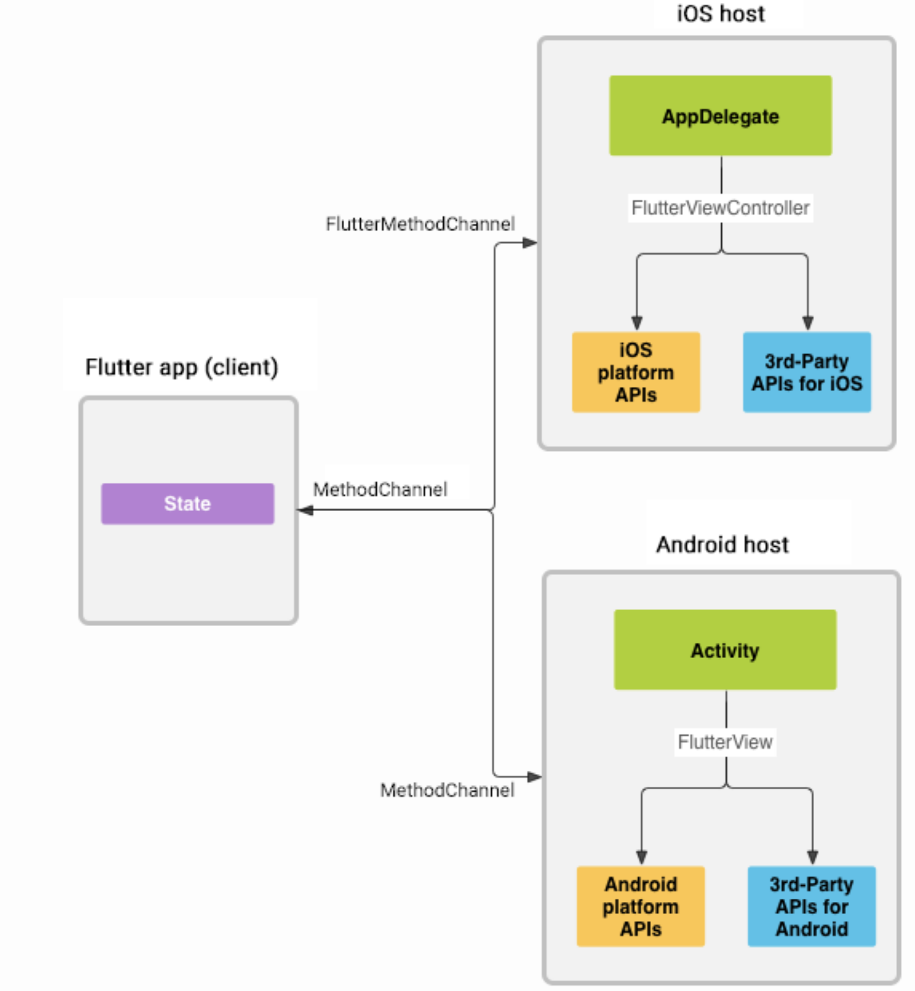
Agenda
How to call Native library ?
Implement native functions using :
Delegate(ios)
or
interfaces/abstractions(Android)

Slide 14
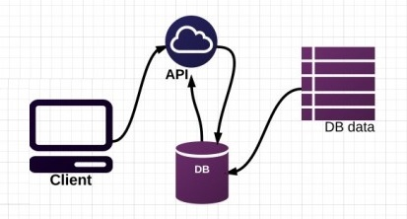
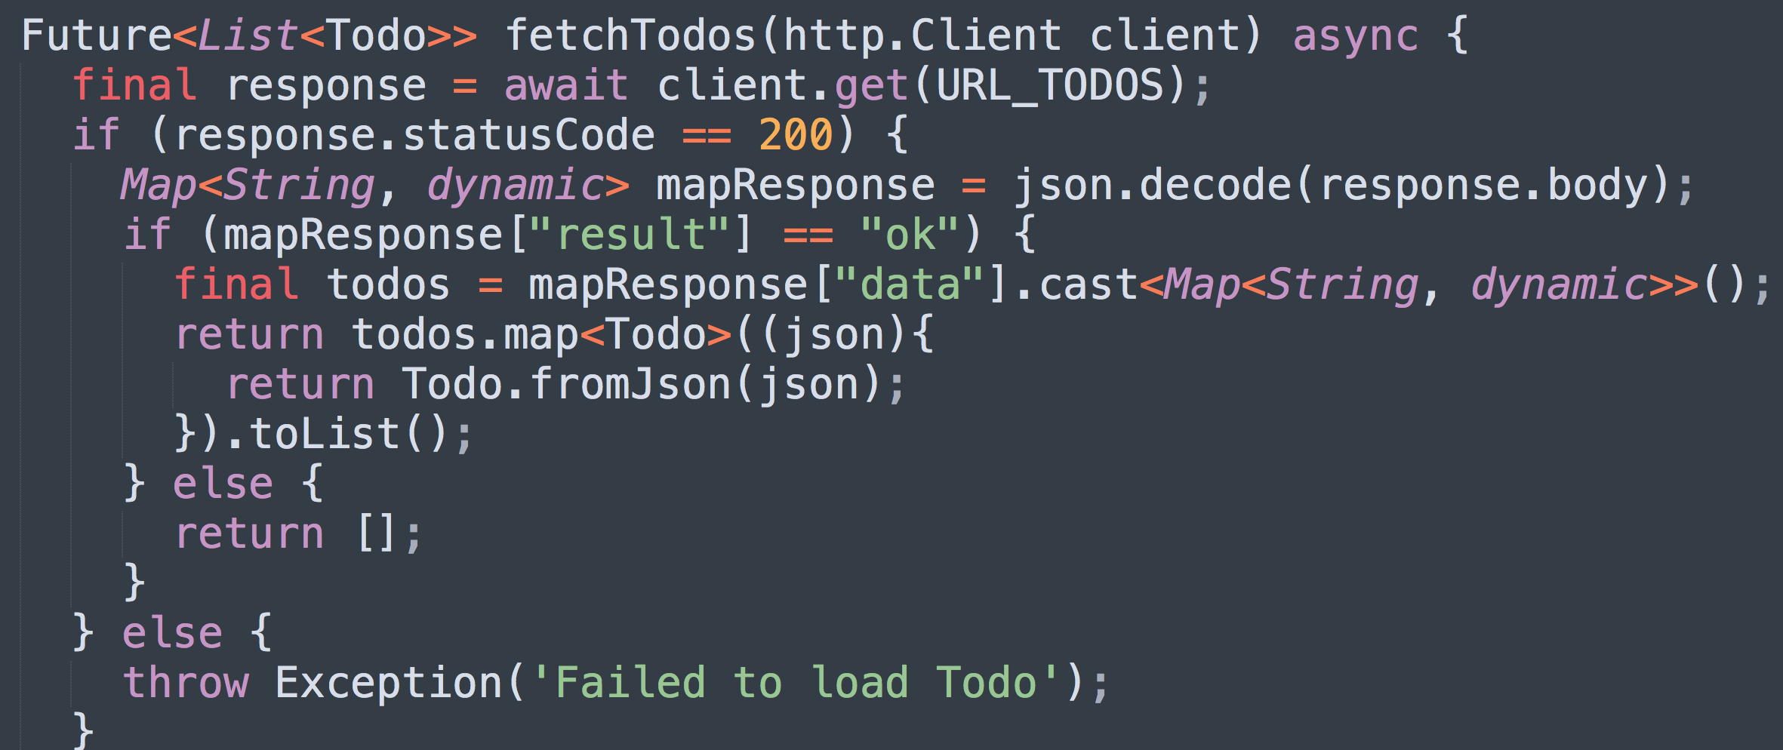
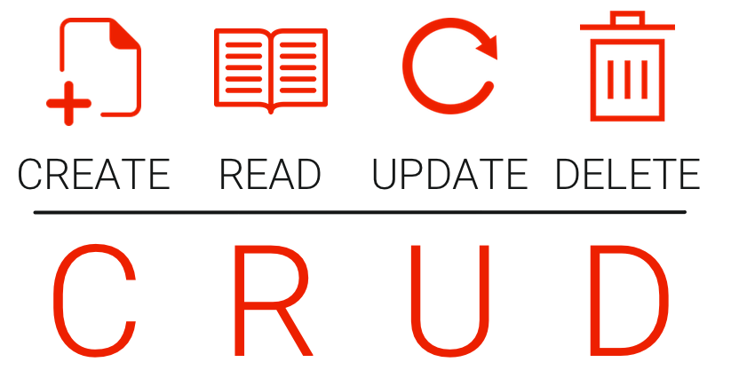
Agenda
How to fetch Restful api ? => Use http package

Slide 15
Agenda
Demo apps
- A TodoList app contains: ListView, Navigator, send Restful API
- A GridView app to show image list.

Slide 16
Agenda
Questions and Answers

Slide 17
Thank you!
Thanks for everyone for joining this agenda. You can visit Flutter tutorial videos here:
https://www.youtube.com/c/nguyenduchoang

